Slide 1
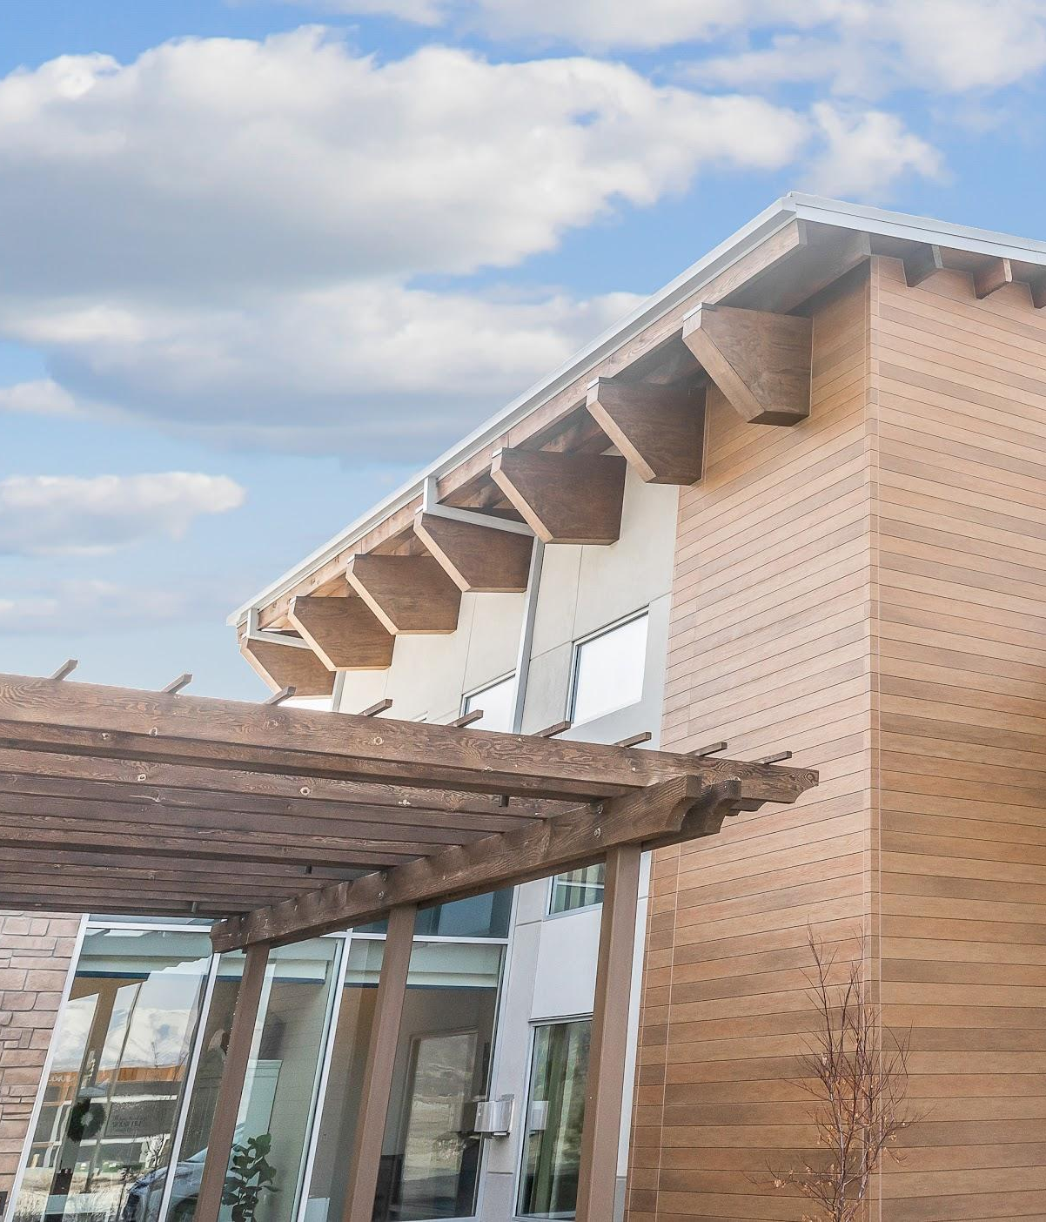
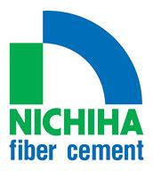
EXTERIOR
SOLUTIONS
For Your Commercial Project

Slide 2

INNOVATIVE
SOLUTIONS

Slide 3
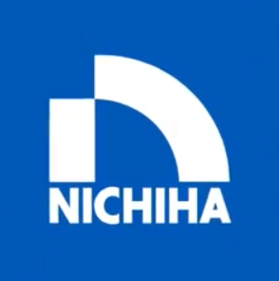
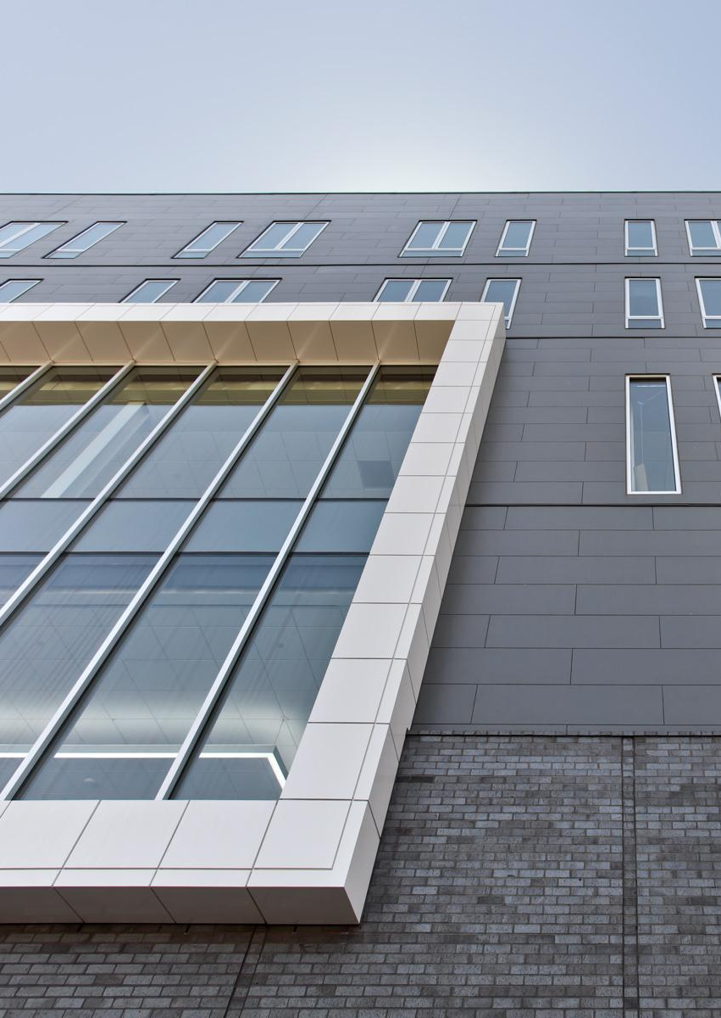
INNOVATIVE SOLUTIONS
Benefits of high-performance fiber cement cladding:
Low-emitting materials help you qualify for LEED
or other green building credits.
Our products are manufactured with sustainability
in mind and tested to the most strenuous safety standards.
A built-in rainscreen reduces the possibility of mold and mildew.
Our ultimate clip system reduces labor and costs
for installation.

Slide 4
IMPACTFUL DESIGN
SOLUTIONS

Slide 5
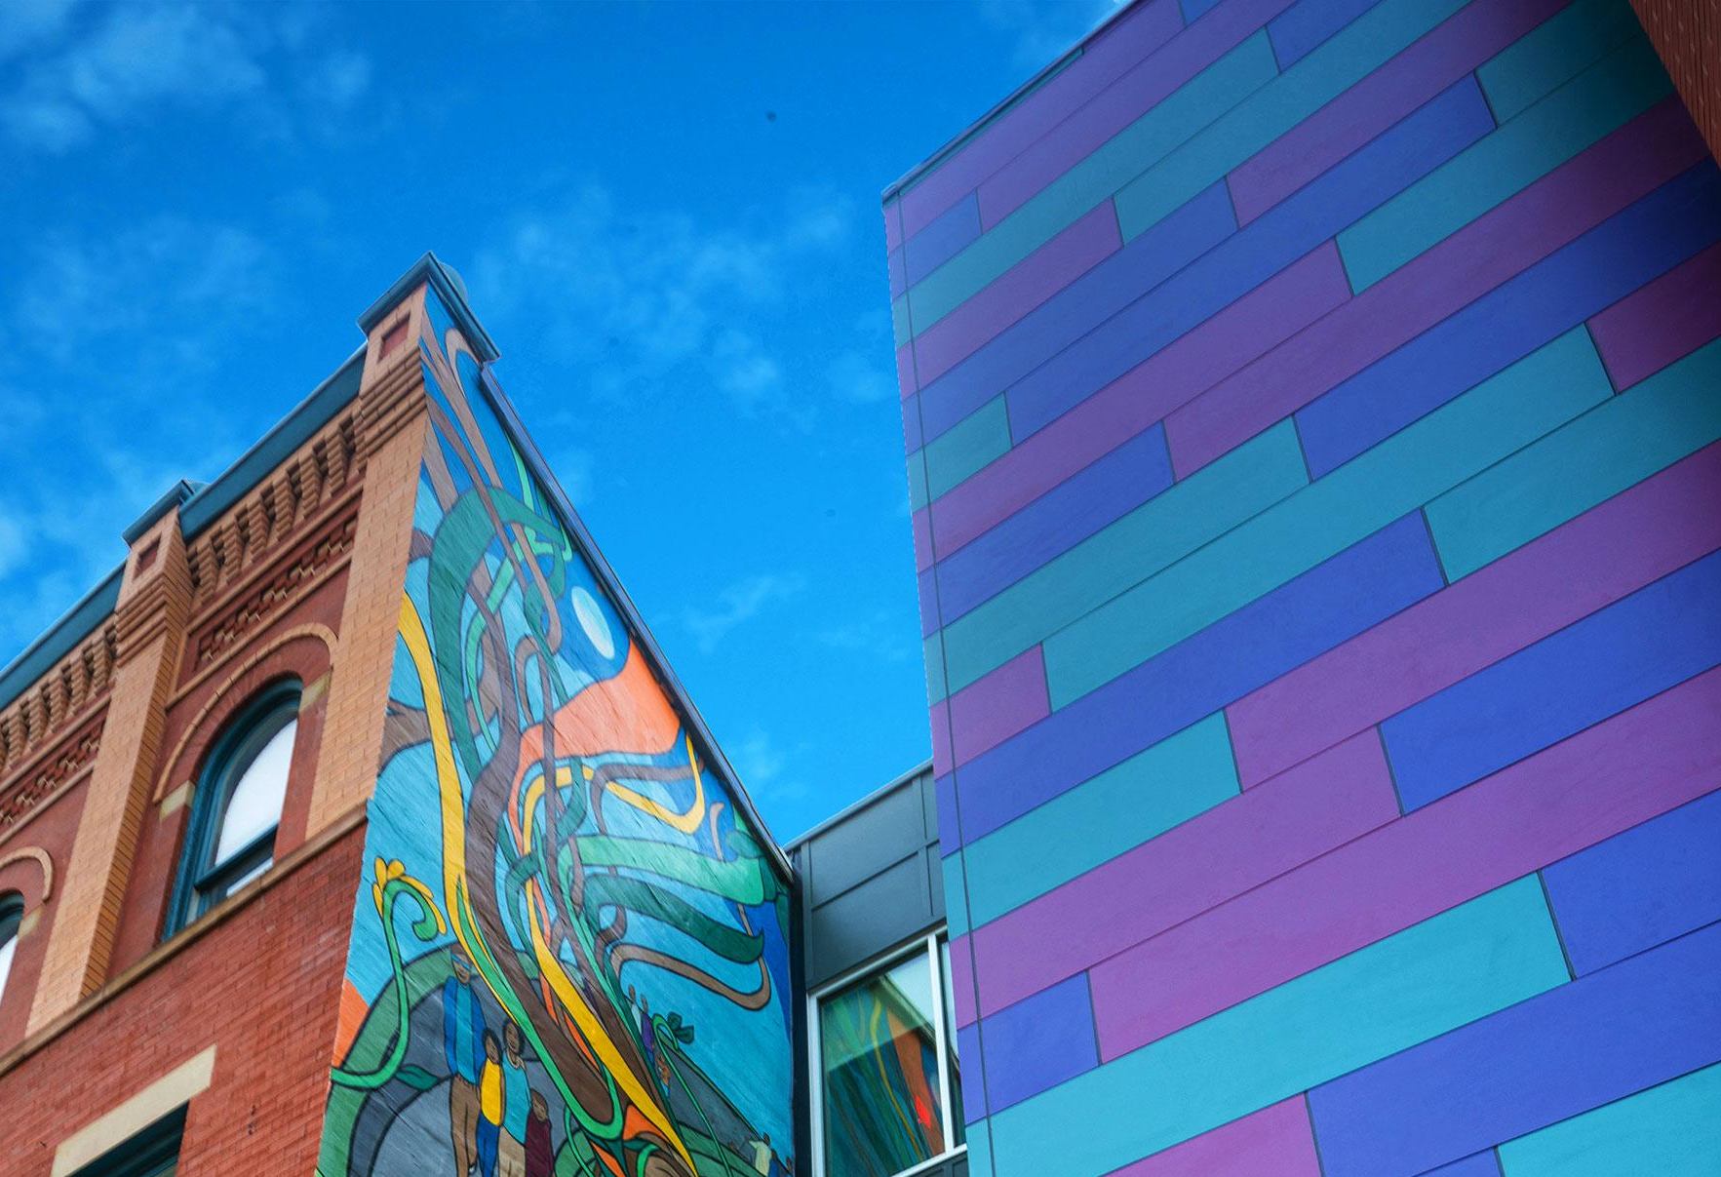
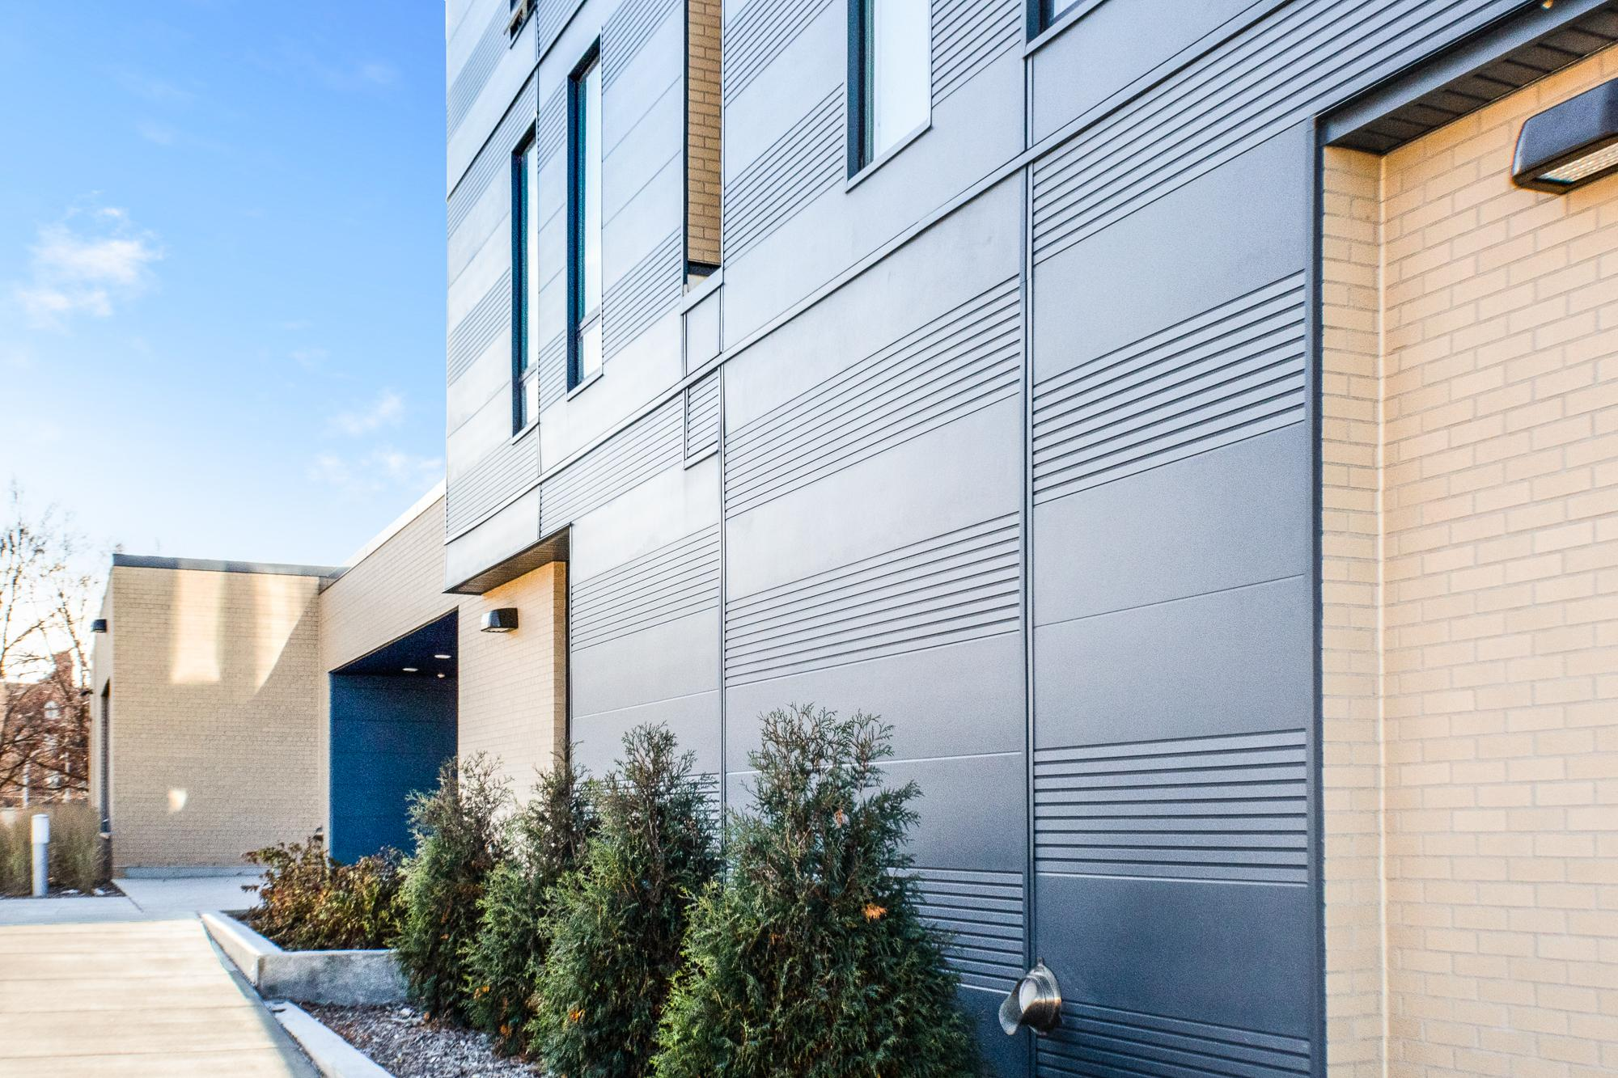
IMPACTFUL DESIGN
SOLUTIONS
Create more design impact! Nichiha offerings include:
Miria and Illumination Panels
  High-gloss designs with loads of style
Ribbed Panels
  A touch of texture and bold colors
VintageWood
  The classic look of wood to add warmth
EmpireBlock and IndustrialBlock Panels
  An industrial and modern concrete look

Slide 6
INSTALLATION
SOLUTIONS

Slide 7
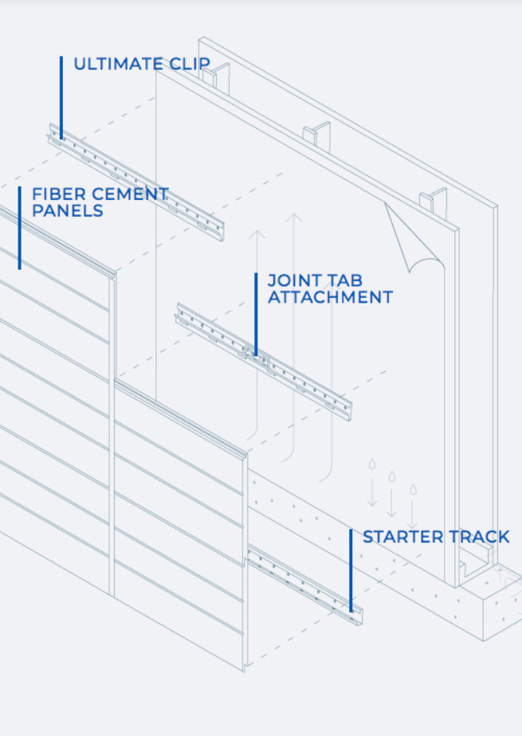
INSTALLATION SOLUTIONS
Our clip-installation process saves time and money.
An all-in-one solution for installation.
This system uses clips so your design isn’t ruined by unsightly nail and screw holes. The patented track system is also designed with a drainage channel to keep water and moisture away from the building envelope, preventing mold and water damage.

Slide 8
RESILIENT
SOLUTIONS

Slide 9
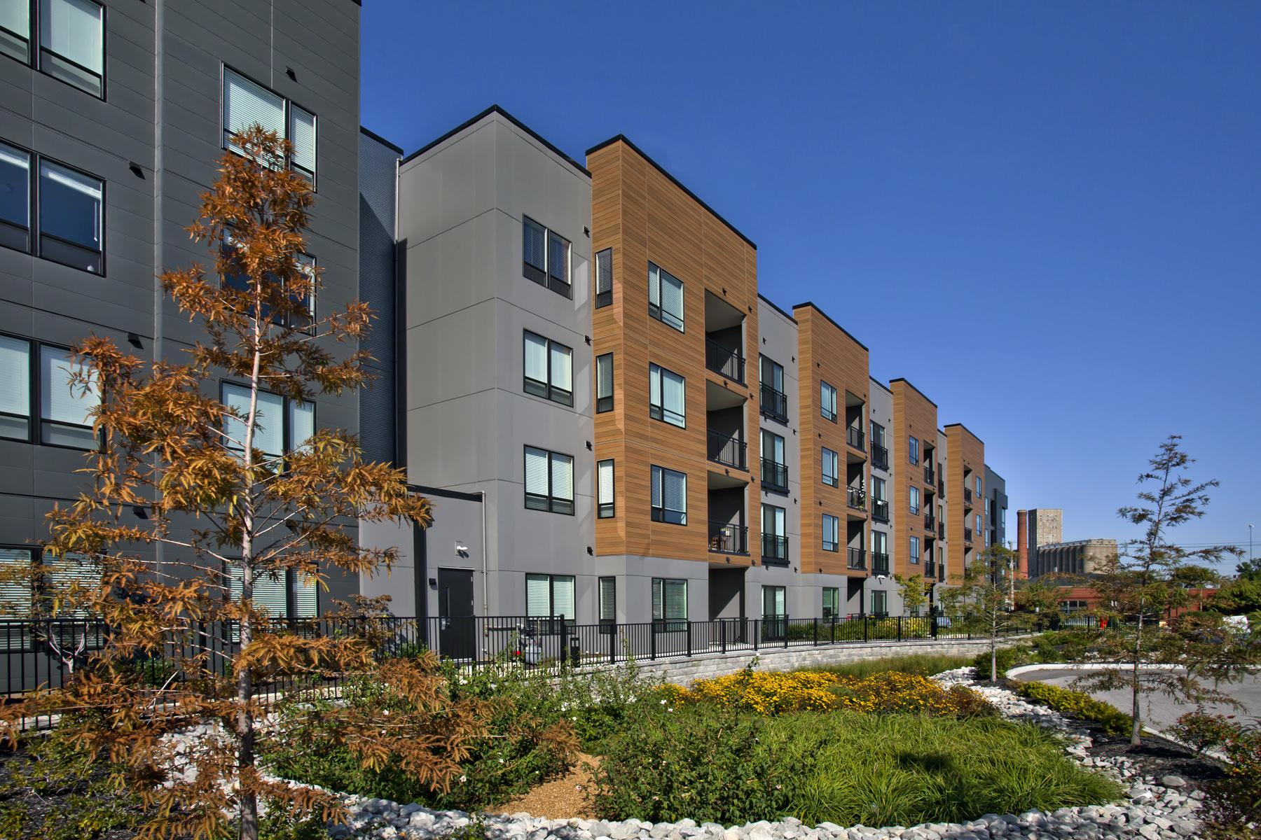
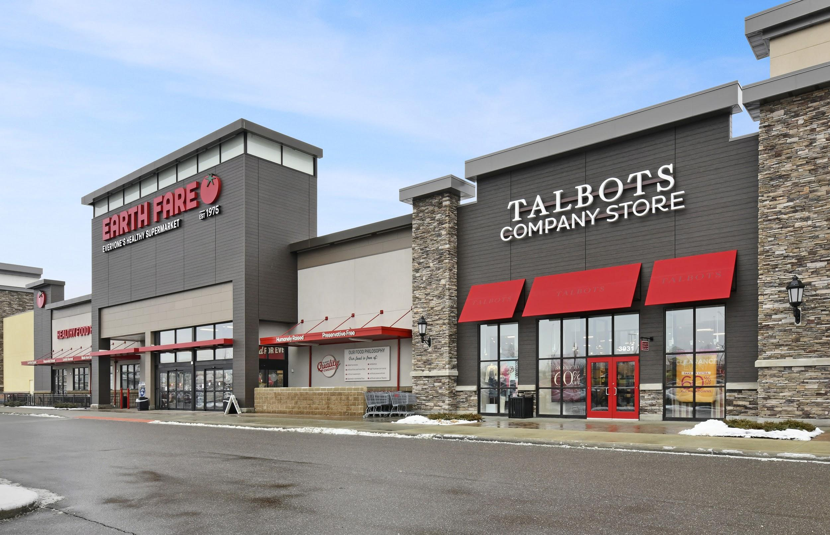
RESILIENT SOLUTIONS
Protect your building long after it’s installed.
Nichiha products are tested to industry standards for weather protection, fire resilience and safety.
Nichiha’s Architectural Wall Panels meet wind load codes in Miami-Dade and Los Angeles, the two strictest regulations in the country.
Architectural Wall Panels come with up to a 30-year limited warranty
With proper yearly maintenance, the product will last for decades.

